Slide 1






IEEE CIS Hackathon
(Organized BY MNIT, Jaipur)
Sponsors
Team Name : ASI-J1
Team Leader :
Team Member :
Gaurav Rathore
Aditi Agarwal
Problem :
Statement
AI-based career counselling from
class 10th to college level students
College Name:
Government Engineering College Ajmer

Slide 2
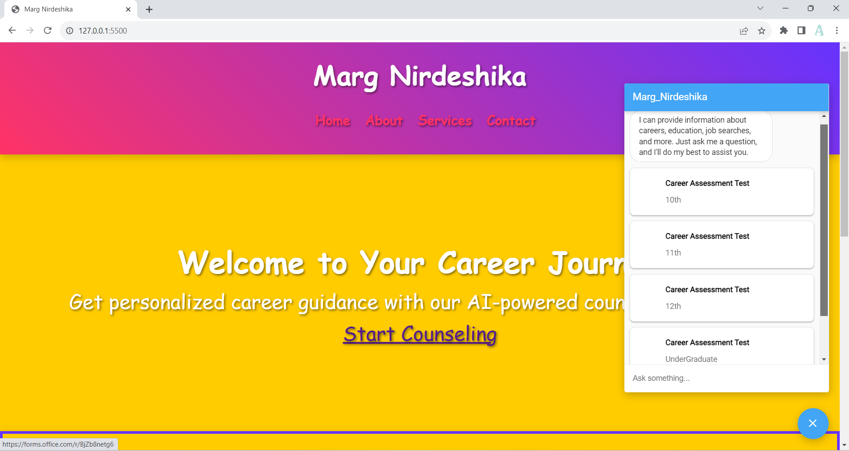
PROTOTYPE
AI-BASED CAREER COUNSELLING CHAT BOT- MARG-NIDARSHIKA

Slide 3
STEP 1: assessment test
Levels
10th
12th
Undergrad
11th
CRITERIA:
Personality assessment
Interest evaluation
Strength and skill evaluation
BASIS: Birkman’s method of evaluation

Slide 4
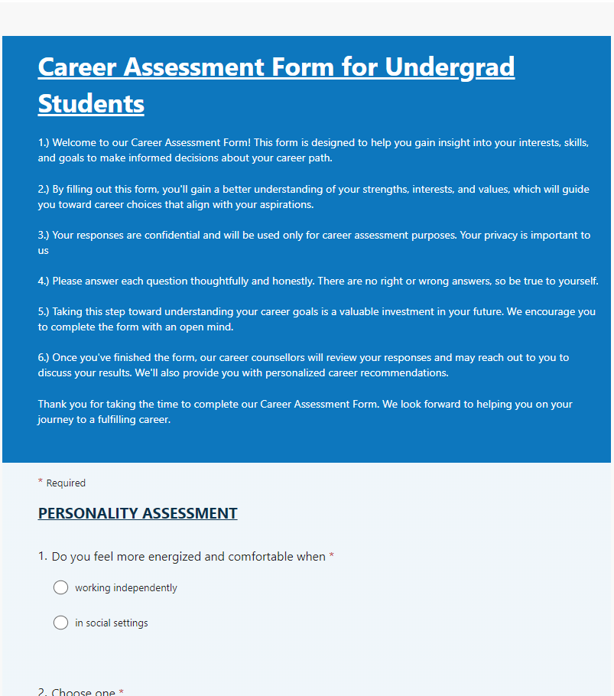
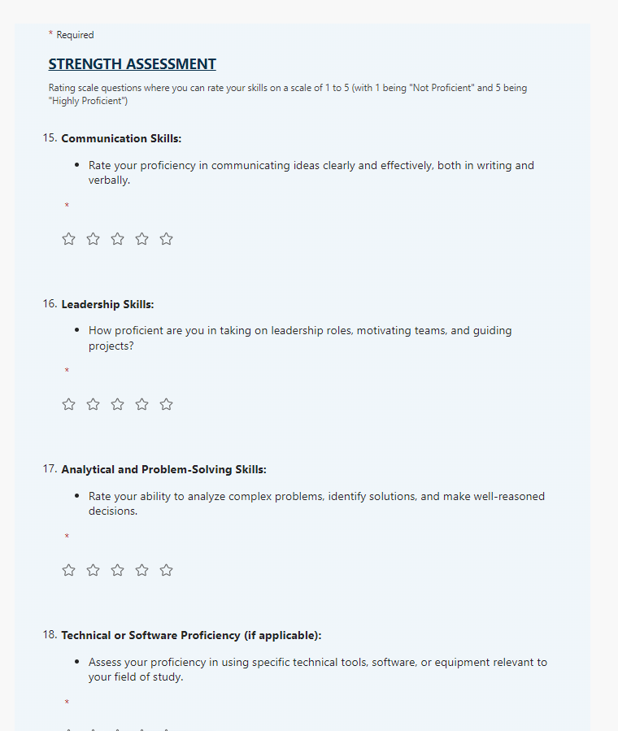
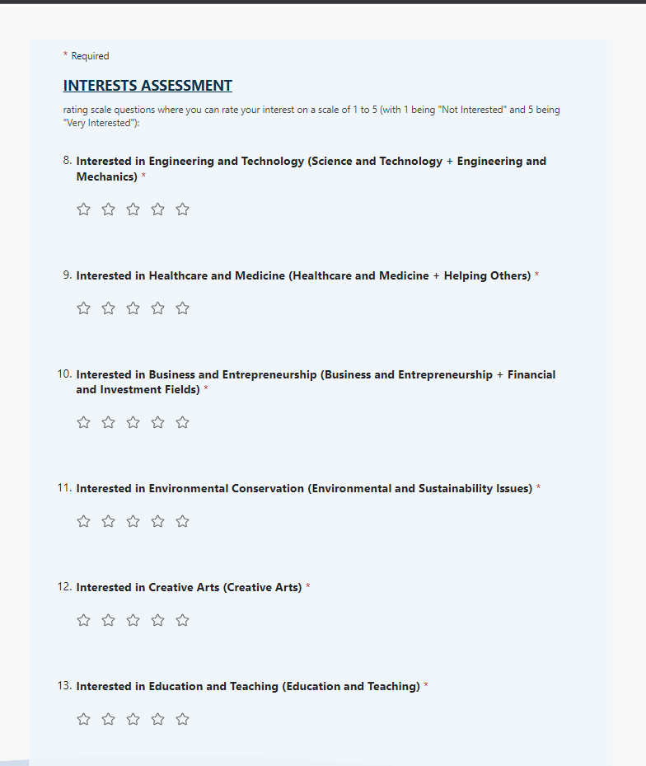
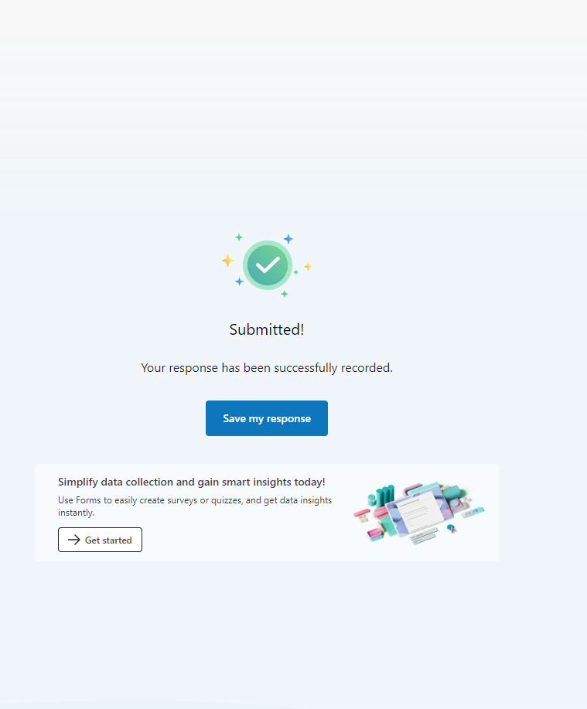

Slide 5
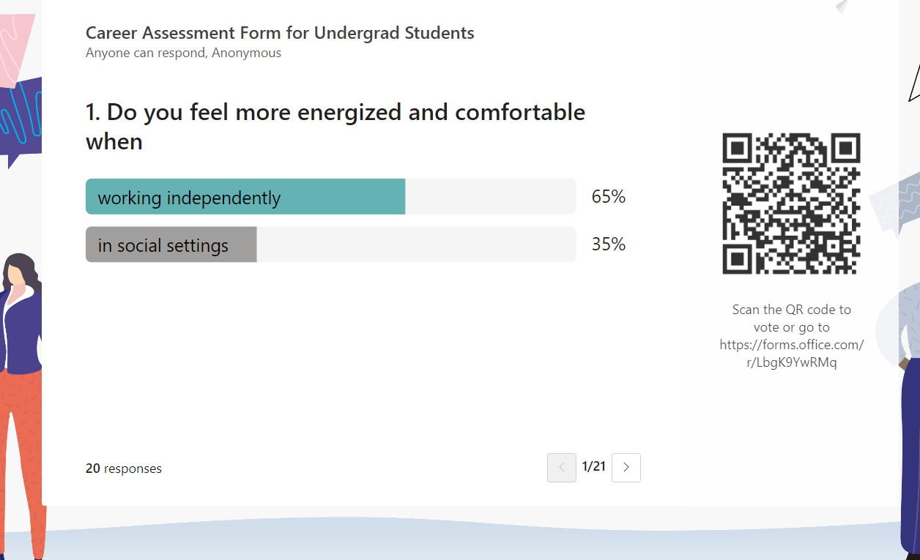
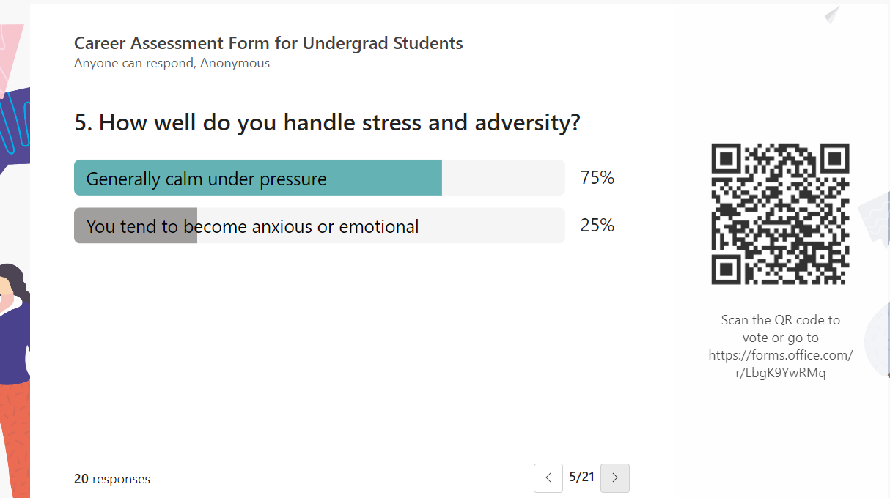
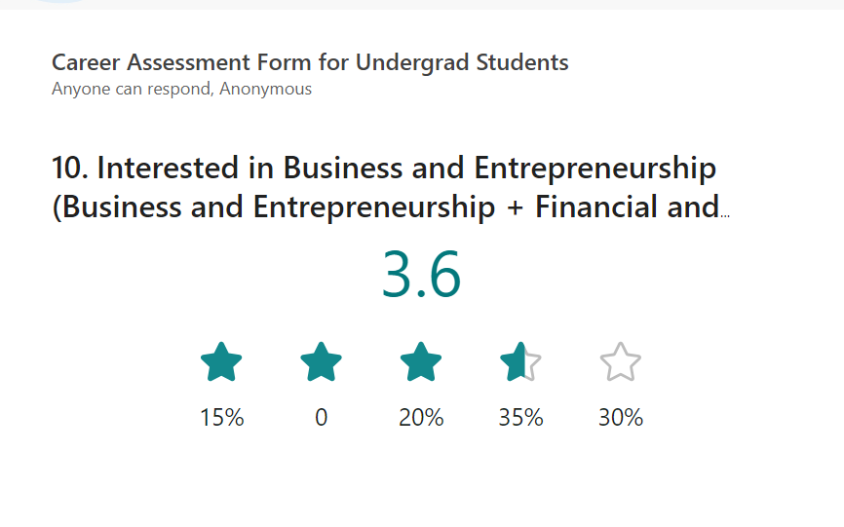
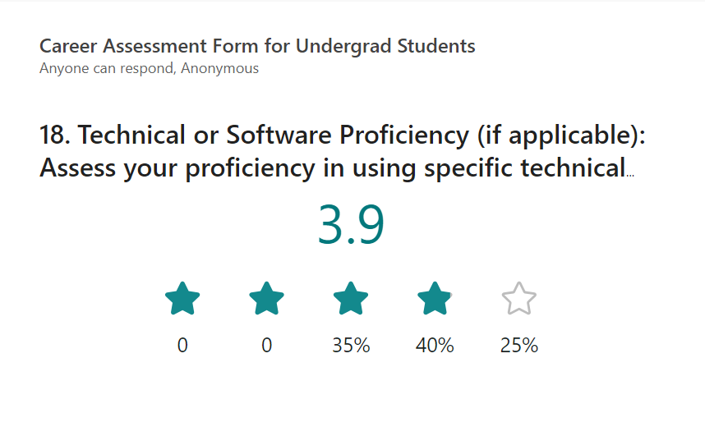
Response Measure

Slide 6
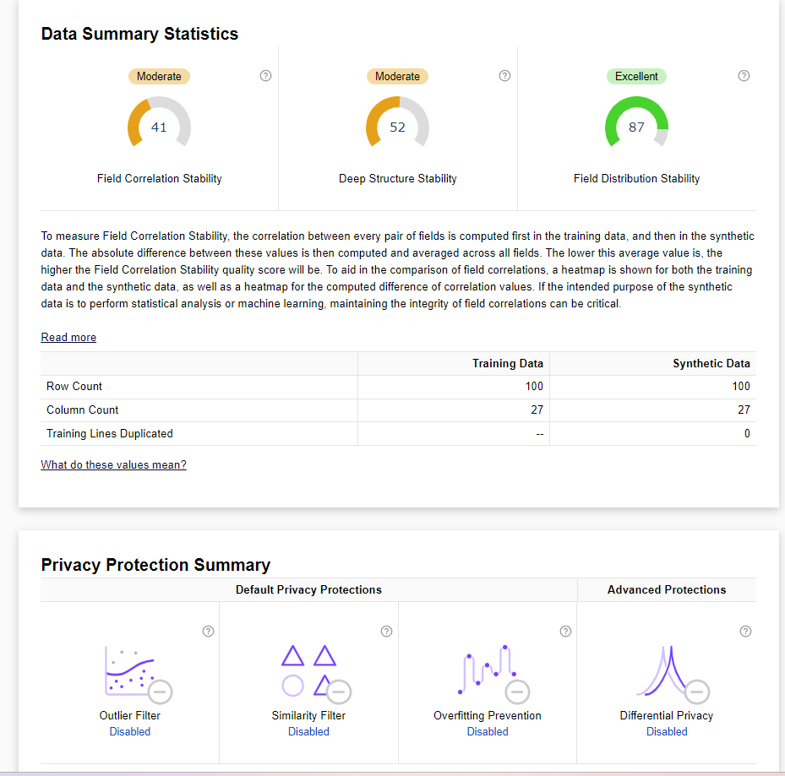
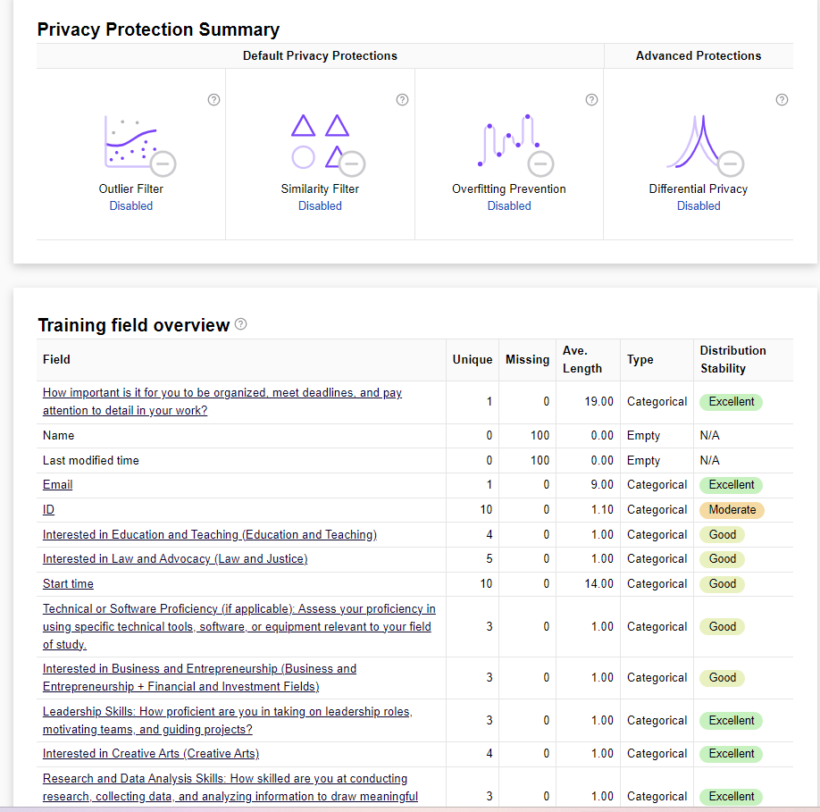
Data Evaluation

Slide 7
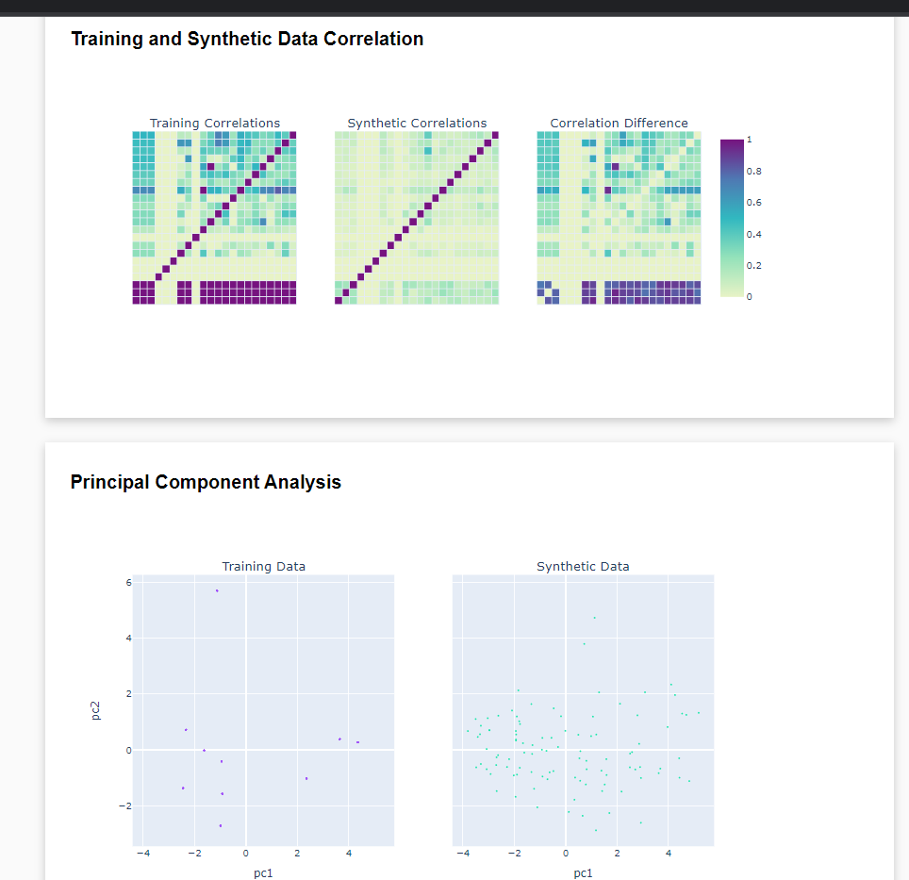
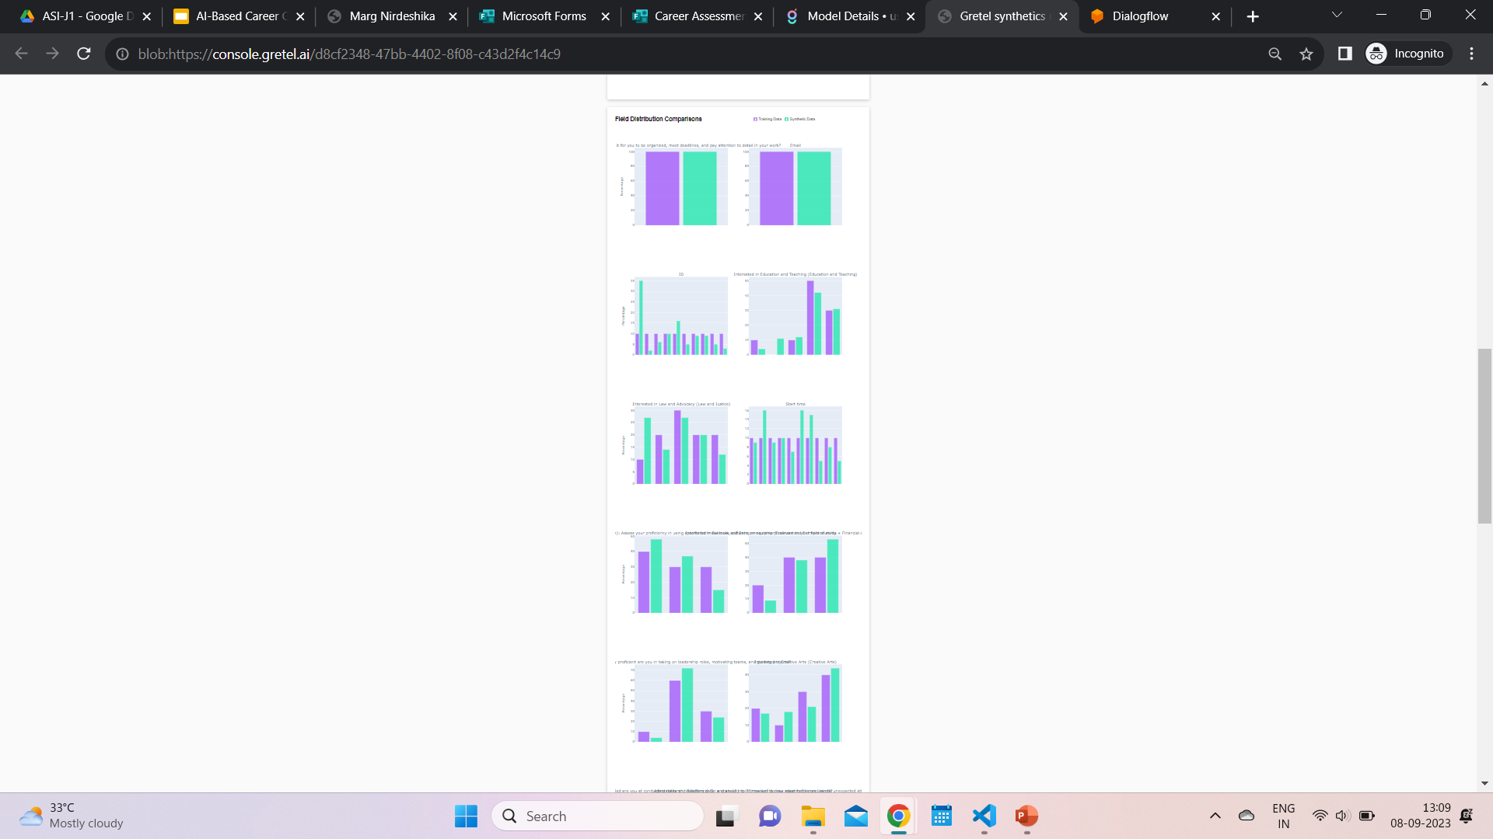

Slide 8
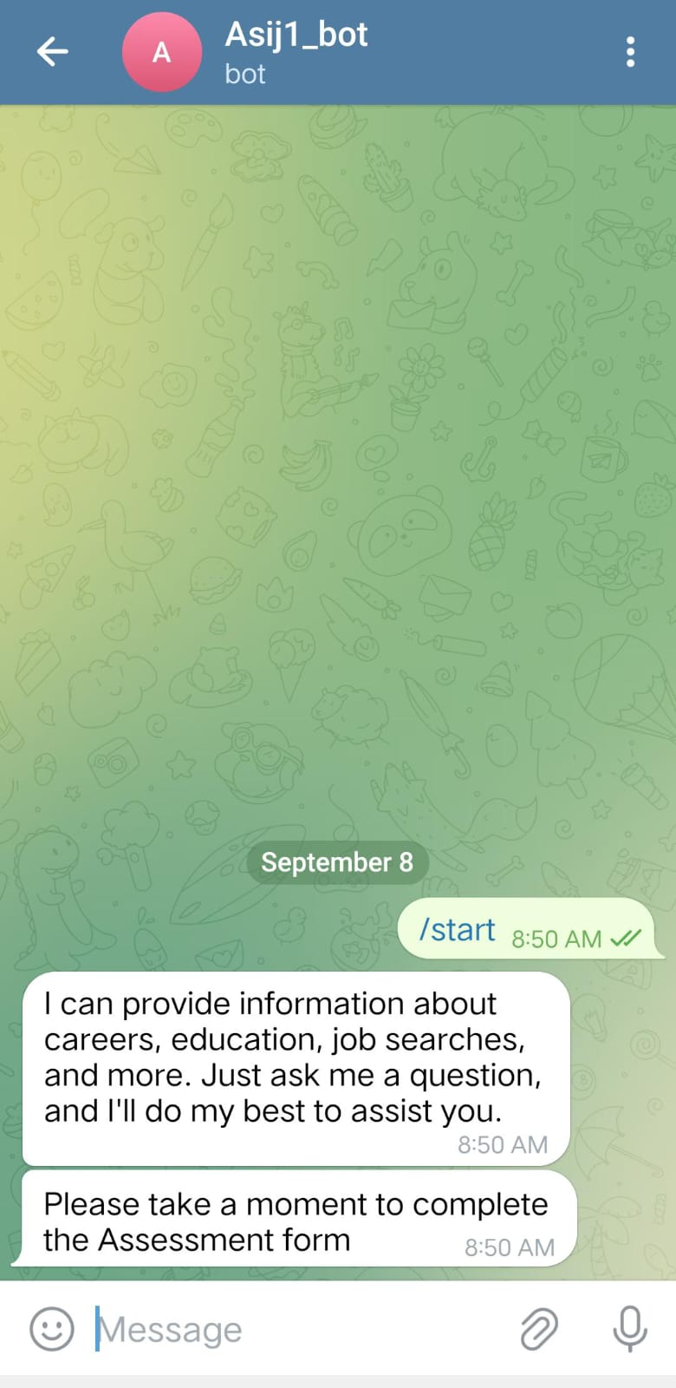
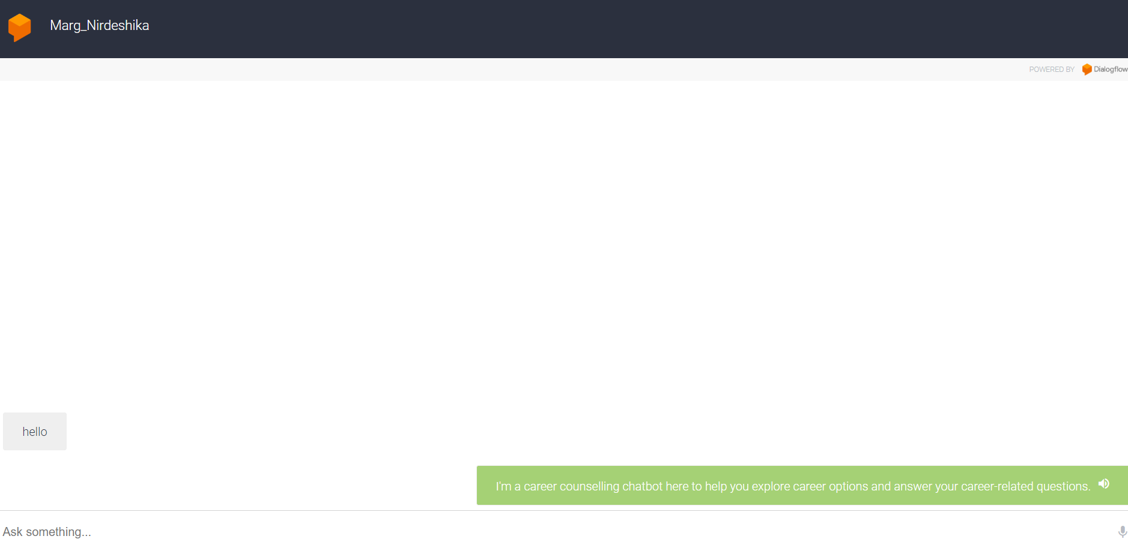
PLATFORMS INTEGRATED
Web bot
Telegram Bot

